Slide 1

US Accident ANALYSIS funded by Department for road safety of USa
Urvish Patel
(Chief-Executive of the project)

Slide 2
Problem & Surrounding questions.
With increase in Road accidents, the department wants to know the following things.
Which state has the highest number of accidents?
Which Zip code/County that has the highest number of accidents?
At what time do accidents usually occur in the US?
At what day of week accidents occur most?
What are the Factors Affecting Accident Severity?
Predicting the location of the accident.
Predicting the accident prone zone in each state.
Predicting the number of accidents might occur in next few years.
Getting possible trends in Number of accidents. (Like every March of each year has highest number of accidents).

Slide 3
To assess the current situation on Accidents happening all over the states.
To focus on critical issues, goals and objectives.
To inforce action plans to reduce accidents on roads.
To identify and add on barriers for the safety of road travellers.
1
Purpose
2
3
4

Slide 4
Introduction to data
Data SOURCE:
Traffic streaming APIs that broadcast live events
Data reported by the relevant police department
US and state departments of transportation
Law enforcement agencies
Traffic cameras
Traffic sensors within the road-networks whenever an accident occurs.
Data COLLECTION METHODOLOGY:
A real-time framework that collects important events (e.g. accidents)

Slide 5
Data Insight
This project includes 1,516,064 rows and 47 columns. Some important columns are listed below.
The dataset used covers 49 states of the USA.
The accident data are collected from February 2016 to Aug 2019
Describes the exact location of accident and the distance of traffic which is affected after an incident occurs.
Severity, it shows the severity of the accident, a number between 1 and 4, where 1 indicates the least.
Distance(mi), shows the length of the road extent affected by the accident.
Description, shows natural language description of the accident.
City, County, State, Zip code, & Country
Temperature(F), shows the temperature (in Fahrenheit).

Slide 6
Data Insight (Continued)
Wind_Chill(F), Shows the wind chill (in Fahrenheit).
Humidity(%), Shows the humidity (in percentage).
Pressure(in), Shows the air pressure (in inches).
Visibility(mi), Shows visibility (in miles).
Wind_Direction, Shows wind direction.
Wind_Speed(mph), Shows wind speed (in miles per hour).
Precipitation(in), Shows precipitation amount in inches, if there is any.
Weather_Condition, Shows the weather condition (rain, snow, thunderstorm, fog, etc.)
Sunrise_Sunset, Shows the period of day (i.e. day or night) based on sunrise/sunset.
Civil_Twilight, Shows the period of day (i.e. day or night) based on civil twilight.
Nautical_Twilight, Shows the period of day (i.e. day or night) based on nautical twilight.
Astronomical_Twilight, Shows the period of day (i.e. day or night) based on astronomical twilight.

Slide 7
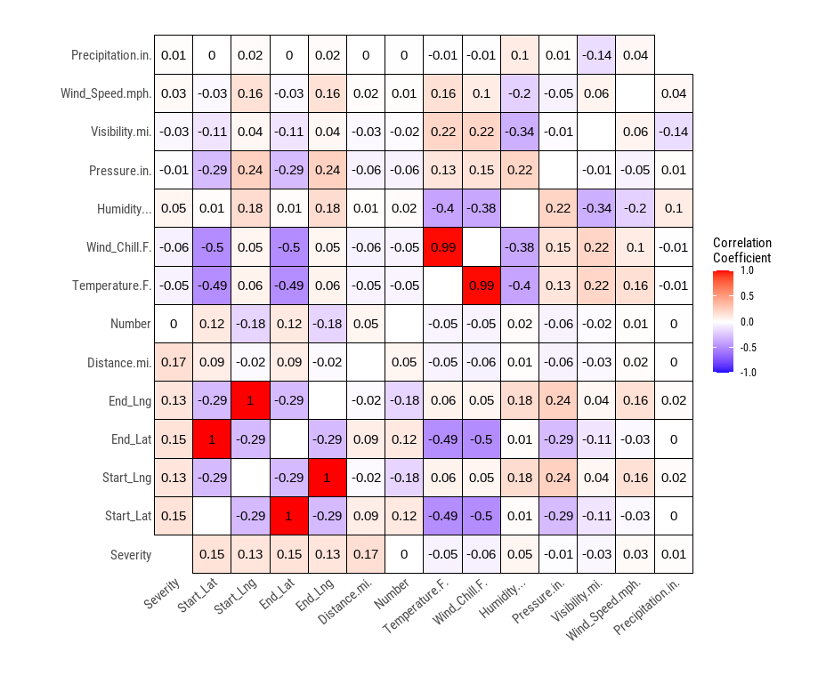
Data Insight (Continued)

Slide 8
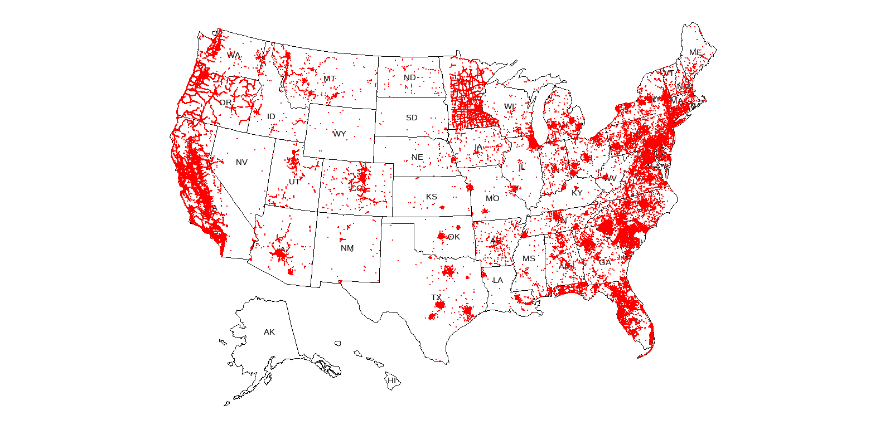
Data Insight (Continued)

Slide 9
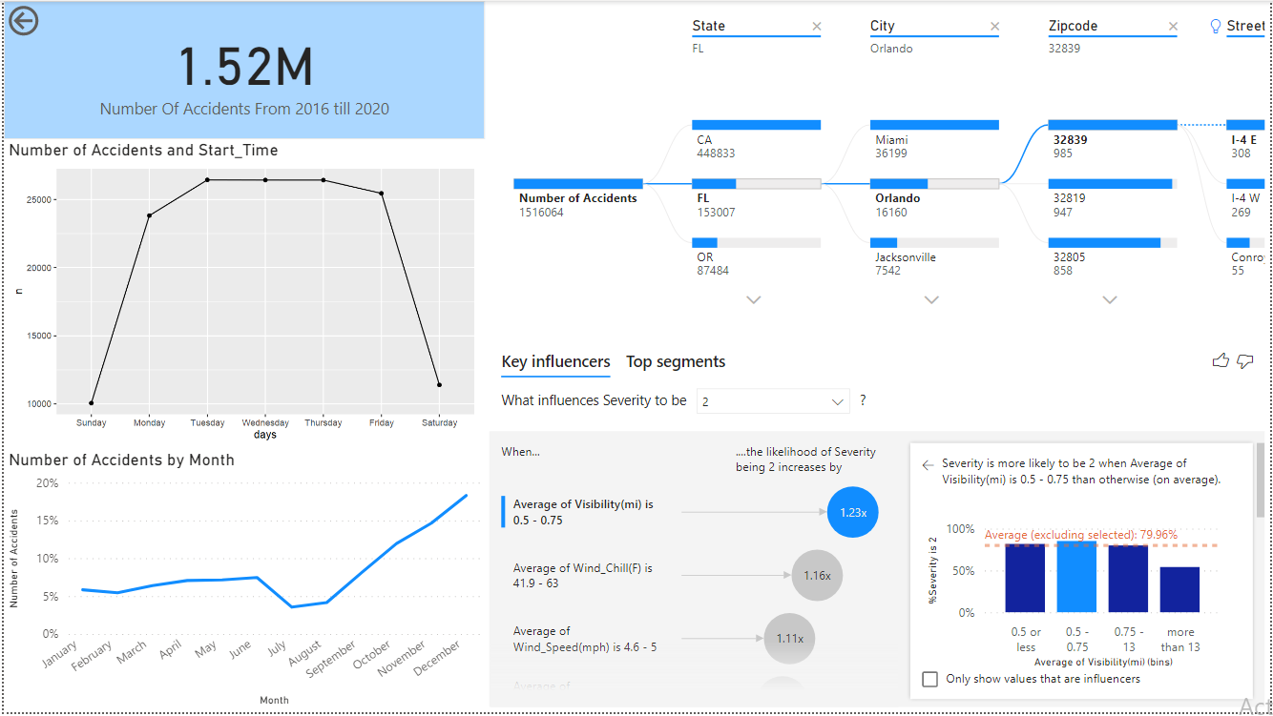
Analysis
What is the number of accidents according to the state, city, zip code and street?
During which Week day accidents occur most?

Slide 10
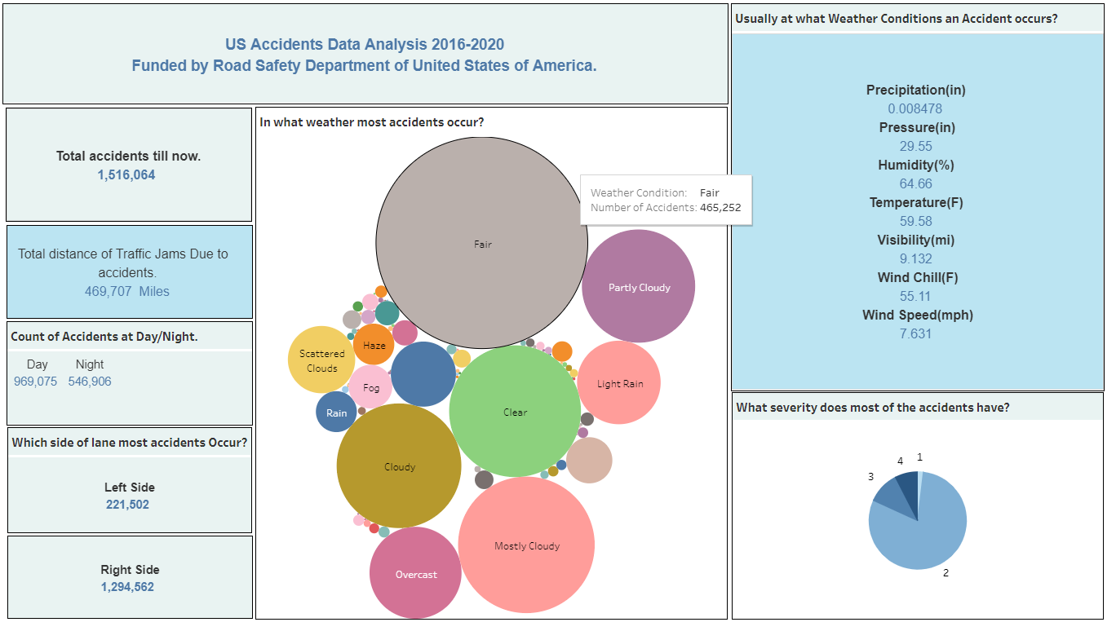
Analysis
In what month most accidents occur?
What is the total number of accidents till now?
What is the total distance in miles affected by the accidents happening on road?
What is the number of accidents happening in daylight and nightlight?
What is the number of accidents happening on left & right side of a lane?
In what weather most accidents occur?
Usually at what Weather Conditions an Accident occurs?

Slide 11
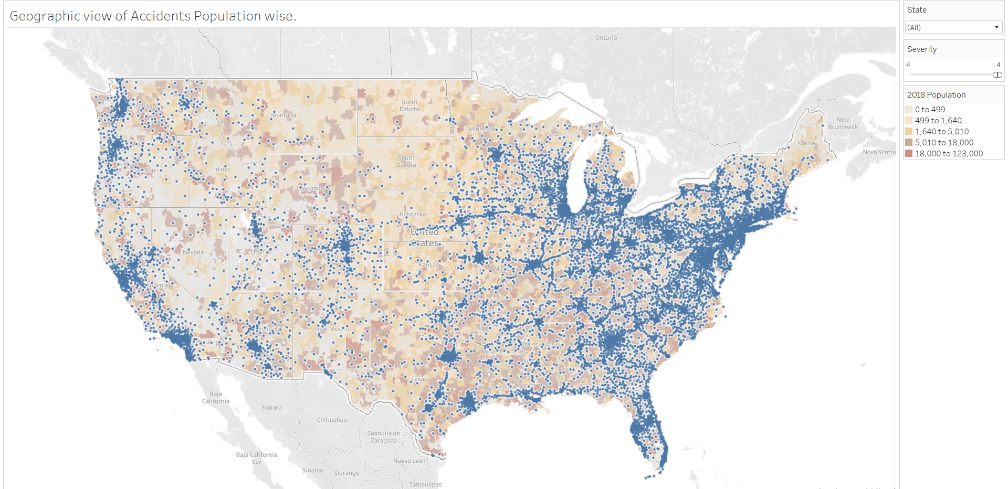
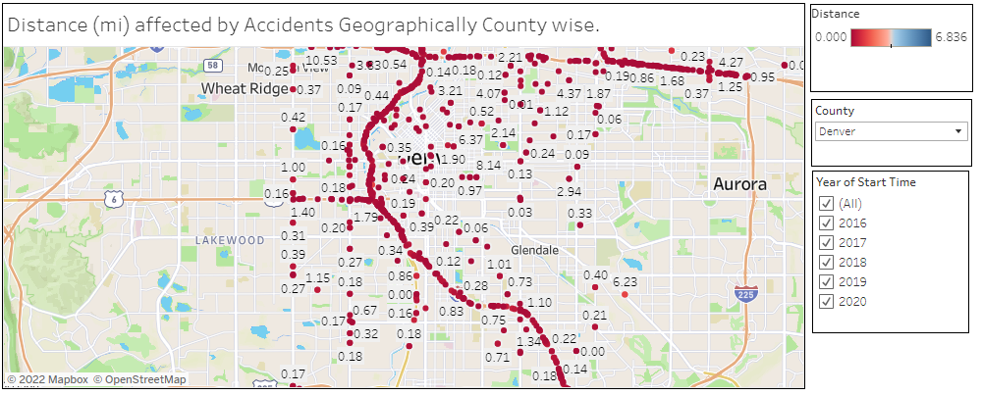
Analysis
What is the overview? In which region most number of accidents occur in USA?
Does the number of accidents depend on population of a county?
What is the Distance (mi) affected by Accidents Geographically?

Slide 12
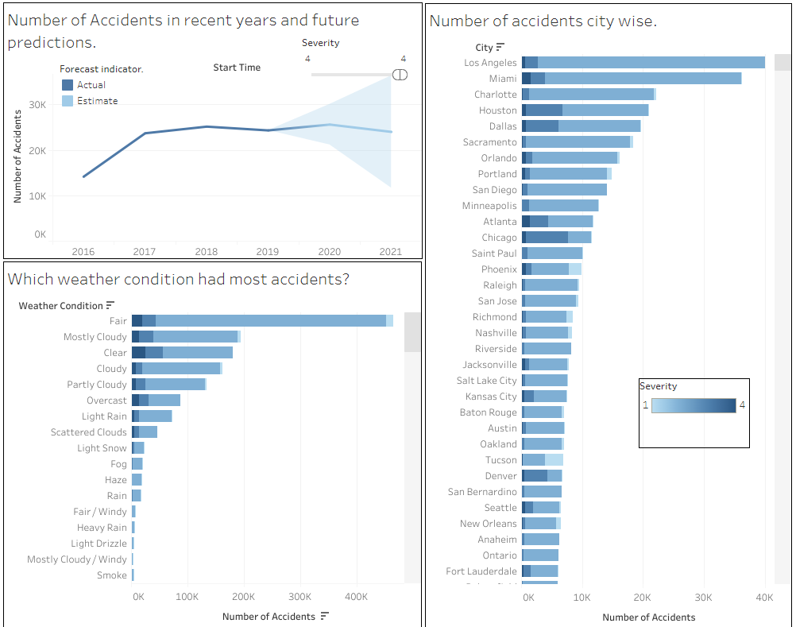
Analysis
What are the predictions for the future?
What number of accidents we can expect?
What is the count of accidents in each city? Where is the highest fatality reported?
In which Weather Condition do accidents occur most?

Slide 13
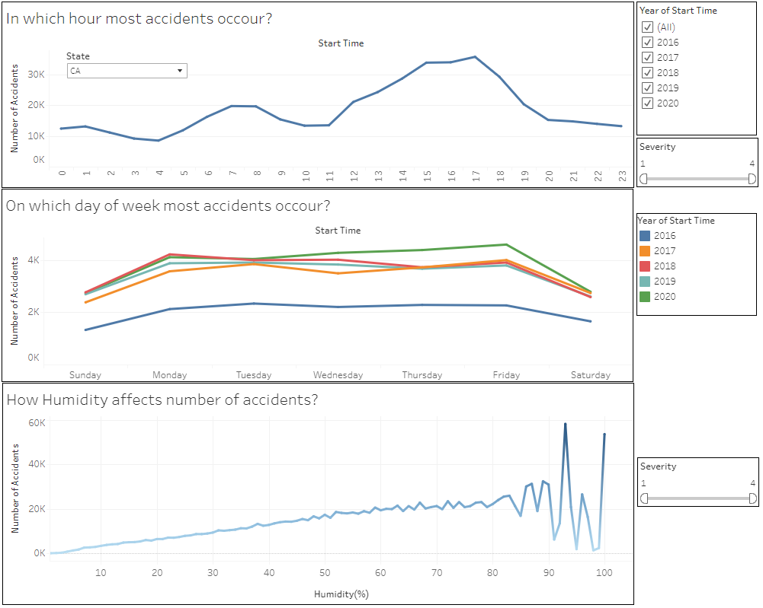
Analysis
Usually at what hour most accidents occur in US?
On which day of week most accidents occur?
How the weather conditions like humidity affects the number of accidents?

Slide 14
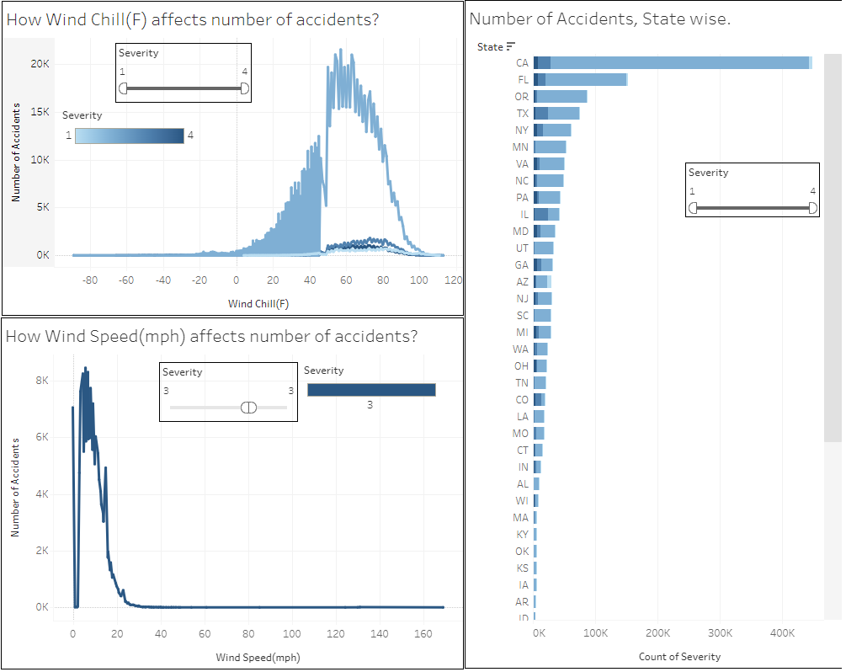
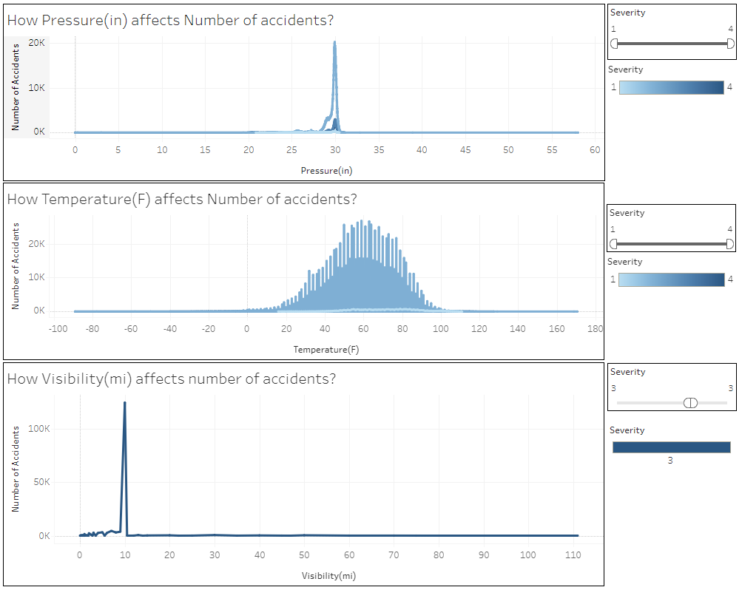
Analysis
How the weather conditions like pressure, temperature, visibility, wind chill, & wind speed affects the number of accidents?
2. What is the count of accidents in each state?

Slide 15
Results / Issues to the problem.
Weather updates
Travelers not getting accurate weather updates beforehand.
Right Lane
Accidents happening due shifting lanes on right side.
Freeways
Accidents due to high speed especially on freeways.
Hospitals
Not enough hospitals near highways.
Distractions
More advertisements on freeways.

Slide 16
Factors Affecting Road Traffic Accidents
D
V
Vehicle factors
Driver Behavior
Vehicle type, and the engineering and the safety design standards for vehicle performance. For example, the design of windshield glass and the location and durability of gas tanks can increase safety. Passenger protection systems in vehicles (i.e. air bags, safety belts), if used, can eliminate injuries or reduce their severity.
Alcohol and drug use, reckless operation of vehicle, failure to properly use occupant protection devices, the use of cell phones or texting, and fatigue.
R
T
Traffic volumes
Roadway characteristics
Average annual daily traffic (AADT) or the vehicle miles travelled (VMT). AADT is the average number of vehicles passing a point along a particular road section each day. Thus, AADT represents the vehicle flow over a road section on an average day of the year. VMT refers to the distance travelled by vehicles on roads. It is often used as an indicator of traffic demand and is commonly applied to evaluate mobility patterns and travel trends.
Road geometries and road side conditions, such as well-designed curves and grades, wide lanes, adequate sight distance, clearly visible striping, flared guardrails, good quality shoulders, roadsides free of obstacles, well-located crash attenuation devices, and well-planned use of traffic signals.
T
Time factors
The season of the year, the month of the year, weekdays, and the hour of crash occurrence.

Slide 17
Recommendations for the issues.
Possible Solutions
The response teams and hospitals must be given special provisions in the hours in which most accidents are occurred.
Warning signs about speed limits are to be put in the accident prone streets.
The state with highest accidents must be provided with better resources and budget plans to avoid accidents and rescue the victims.
Warnings are to be put depending on the weather conditions which cause accidents.
A mandate of vehicles to have first aid kit should be passed.
Online surveillance for prompt response from emergency services should be implemented.
To have enough response teams to rescue in accident prone locations

Slide 18
Target
Reduce Number of Accidents
Reducing at least 40% of predicted accidents by 2022.
Increase Public Transportation
Increasing budget for Public Transportation Vehicles. There should be at leat 30% increase in Public transportation vehicles.
Reduce advertisements
Increase Number of Hospitals near Freeways
Reducing 75% advertisements from Freeways, this will not distract drivers.
Increase at least 30% of Hospitals near freeways. Each hospital should have Special Accident Team for incoming Accident affected persons.
Freeway Emergengy Vehicles
Increasing Budget for EMT Vehicles near Freeways. This should be at leat 25%.
Automobile Industry
At least 75% of automobile industry should include first aid kit during manufacturing of vehicles.
Should we add more?

Slide 19
Thank You!
Any Questions?

